Slide 1
Coursera Capstone
IBM Applied Data Science Capstone
Opening a New Shopping Mall
By: Abdul Muhaimin

Slide 2
Business Problem
• Location of the shopping mall is one of the most important decisions that will determine whether the mall will be a success or a failure
• Objective: To analyse and select the best locations in the city of Kuala Lumpur, Malaysia to open a new shopping mall
• This project is timely as the city is currently suffering from oversupply of shopping malls
• Business question In the city of Kuala Lumpur, Malaysia, if a property developer is looking to open a new shopping mall, where would you recommend that they open it?

Slide 3
Data
• Data required
List of neighbourhoods in Kuala Lumpur
Latitude and longitude coordinates of the neighbourhoods
Venue data, particularly data related to shopping malls
• Sources of data
Wikipedia page for neighbourhoods (https://en.wikipedia.org/wiki/Category:Suburbs_in_Kuala_Lumpur)
Geocoder package for latitude and longitude coordinates
Foursquare API for venue data

Slide 4
Methodology
• Web scraping Wikipedia page for neighbourhoods list
• Get latitude and longitude coordinates using Geocoder
• Use Foursquare API to get venue data
• Group data by neighbourhood and taking the mean of the frequency of occurrence of each venue category
• Filter venue category by Shopping Mall
• Perform clustering on the data by using k-means clustering
• Visualize the clusters in a map using Folium

Slide 5
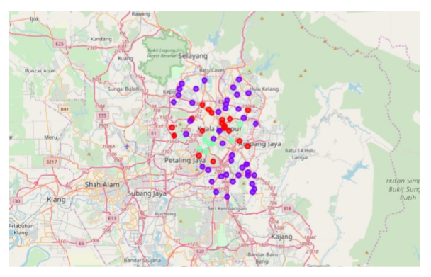
Results
• Categorized the neighbourhoods into 3 clusters :
Cluster 0: Neighbourhoods with moderate number of shopping malls
Cluster 1: Neighbourhoods with low number to no existence of shopping malls
Cluster 2: Neighbourhoods with high concentration of shopping malls

Slide 6
Discussion
• Most of the shopping malls are concentrated in the central area of the city
• Highest number in cluster 2 and moderate number in cluster 0
• Cluster 1 has very low number to no shopping mall in the neighbourhoods
• Oversupply of shopping malls mostly happened in the central area of the city, with the suburb area still have very few shopping malls

Slide 7
Recommendations
• Open new shopping malls in neighbourhoods in cluster 1 with little to no competition
• Can also open in neighbourhoods in cluster 0 with moderate competition if have unique selling propositions to stand out from the competition
• Avoid neighbourhoods in cluster 2, already high concentration of shopping malls and intense competition

Slide 8
Conclusion
• Answer to business question: The neighbourhoods in cluster 1 are the most preferred locations to open a new shopping mall
• Findings of this project will help the relevant stakeholders to capitalize on the opportunities on high potential locations while avoiding overcrowded areas in their decisions to open a new shopping mall

